Slide 1
Conducting Research with Banner Health
Feasibility Review Process

Slide 2
CTSM Department Assignments
Surgery, Pediatrics, Medical Imaging, Ortho, Anesthesiology, Pathology, Ophthalmology, Biomedical/Biosystem Engineering, Gastroenterology, Center for Integrative Medicine, Cardiology & Sarver Heart
Pharmacy; Nursing; Public Health; OBGYN; Emergency Med; Neurology; Psychology; Psychiatry; Family & Community Med; A2DRC; Az Center on Aging; Arthritis Center; Animal & Biomedical Sci; Med Administration; COM Academic & Student Affairs; Geriatrics, General Internal Med, and Palliative Medicine; Inpatient Med; Pulmonary, Allergy, Critical Care, & Sleep Med; Rheumatology; Translational & Regenerative Med; Genetics, Genomics, & Precision Med; Urology
Adult & Pediatric Oncology, Radiation Oncology, Clinical Teaching, Immunobiology, Endocrinology, Cellular & Molecular Medicine, Nephrology, Physiology, Dermatology, Hematology/Oncology, Infectious Disease
Laura Tank
Sara Knight
Sydney Goosen

Slide 3
CTSM
Key Functions
Fostering Relationships
Contract & Feasibility Review
Operational Monitoring & Compliance
Education & Training

Slide 4
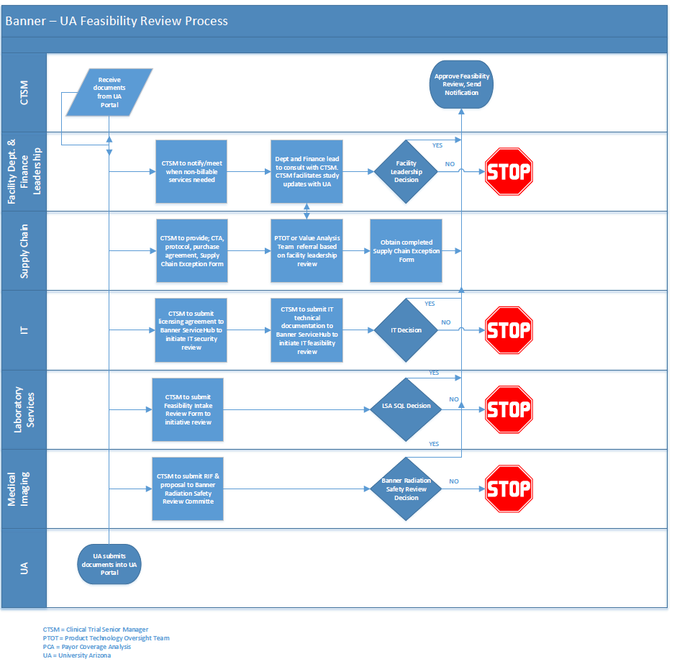
A quick look at the process

Slide 5
Friendly Reminders
It is critically important to submit complete and accurate information in the RIA. Whenever we receive an incomplete application, it adds considerable time to the review process.
Ensure all fields, check boxes, etc. are complete.
If a drug or device study, ensure appropriate documentation is included
Avoid leaving blanks. Insert NA or “Not available at this time”
2. The operational complexity of the study and the number of impacted units will affect turnaround, as we must communicate with each unit to obtain approval.
The process of determining these costs with facility operations and finance oftentimes cause some delays. It is important that we know of these needs upfront/ASAP.
Are laboratory or medical imaging services required?
Are IT services required (hardware, software). Is hardware/software FDA approved?
Who is supplying drug or investigational medication, placebo or comparator drug? What pharmacy support is required?
Are non-billable services required? (Banner staff, equipment, space/lease, etc.)

